Slide 1
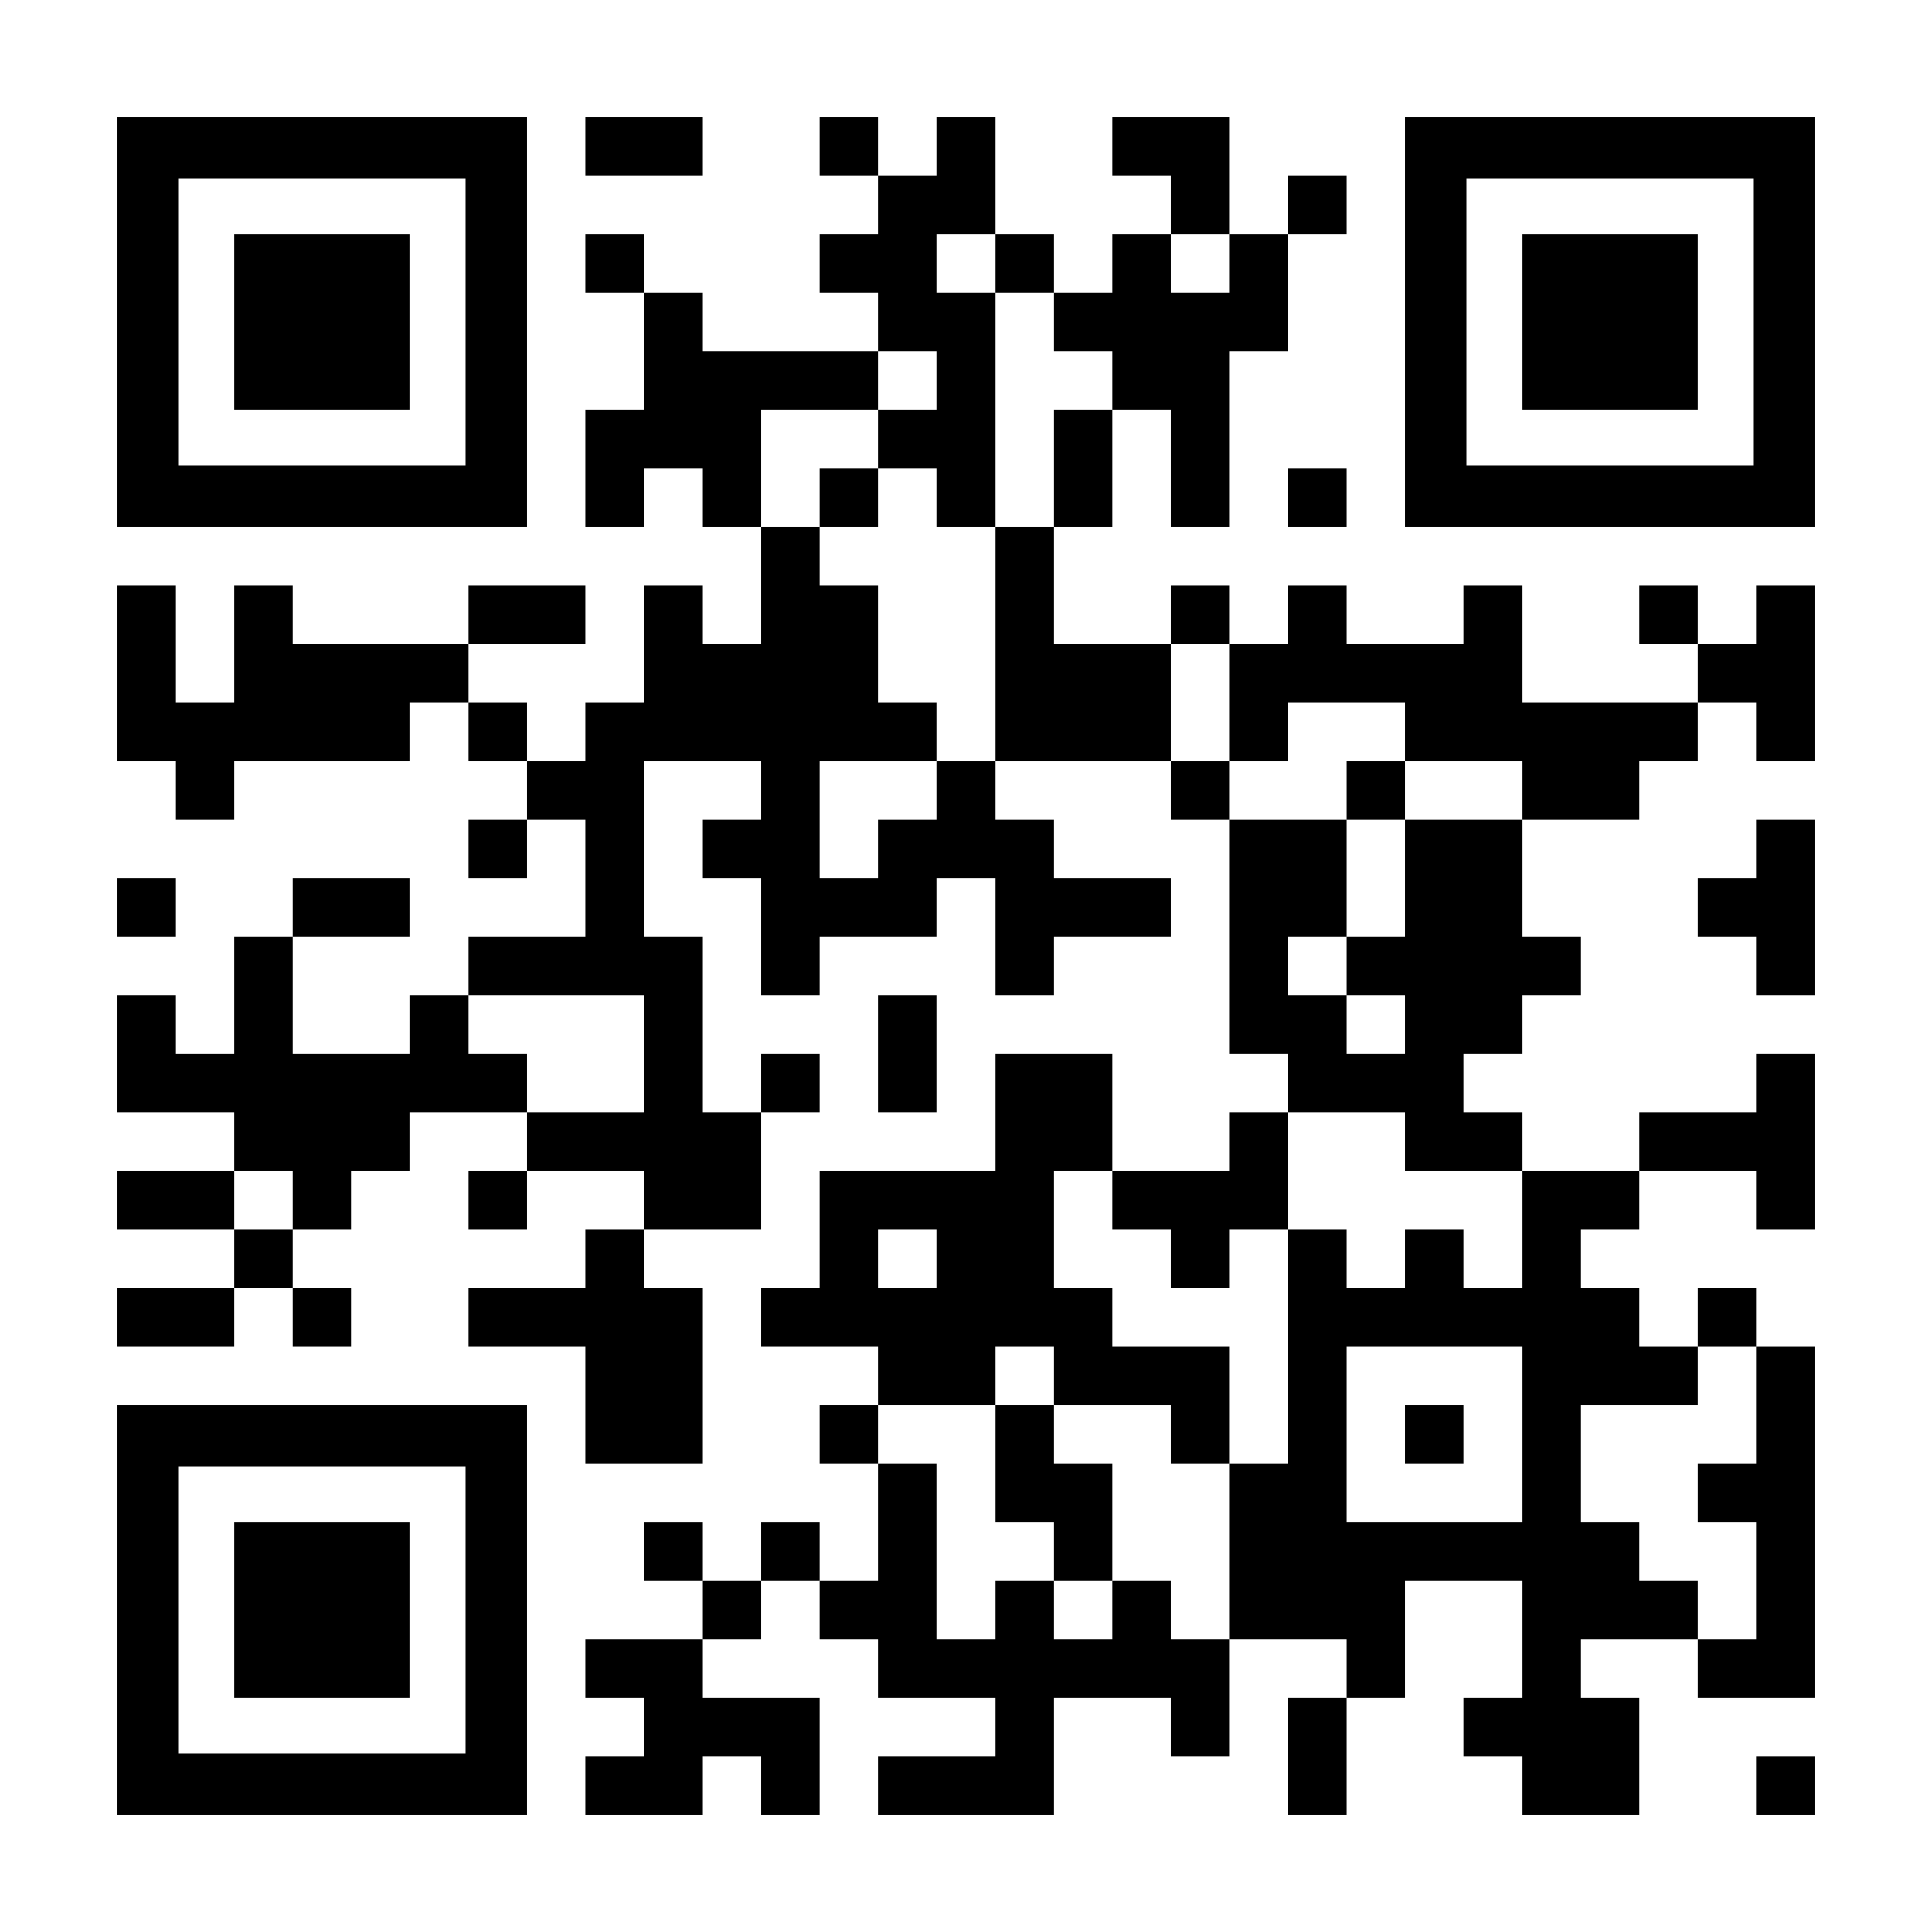
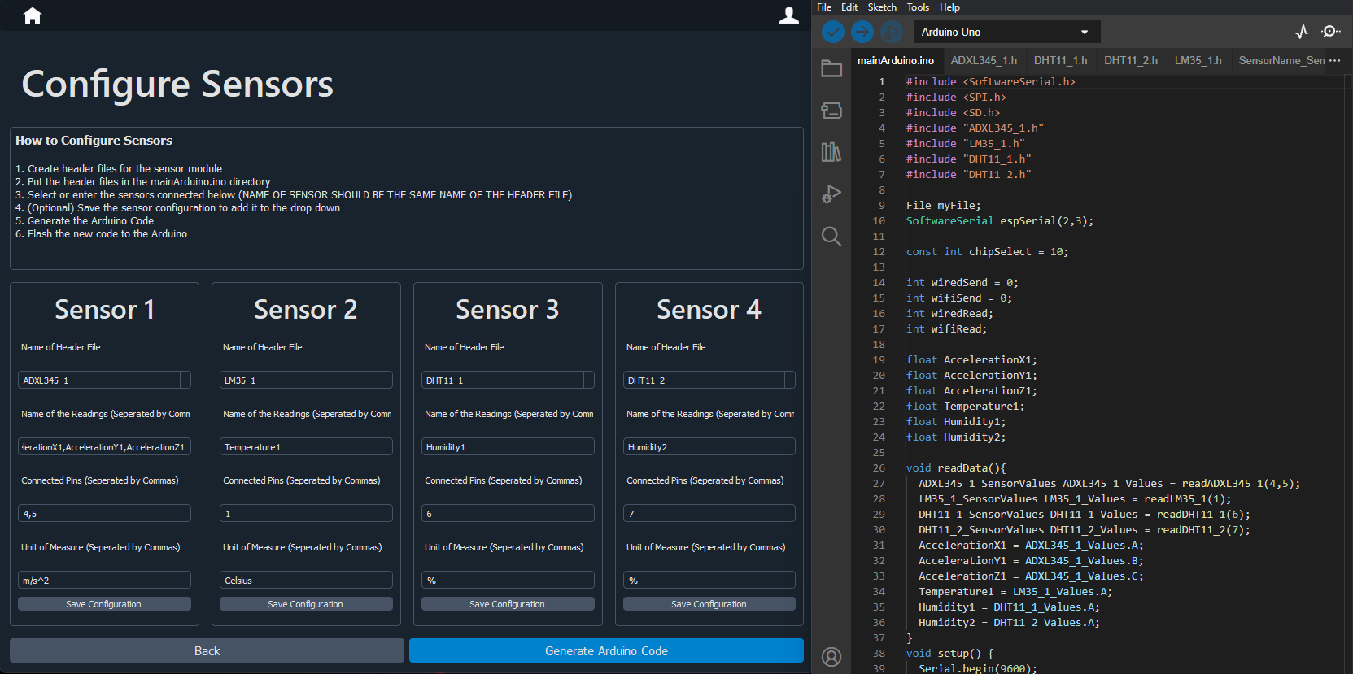

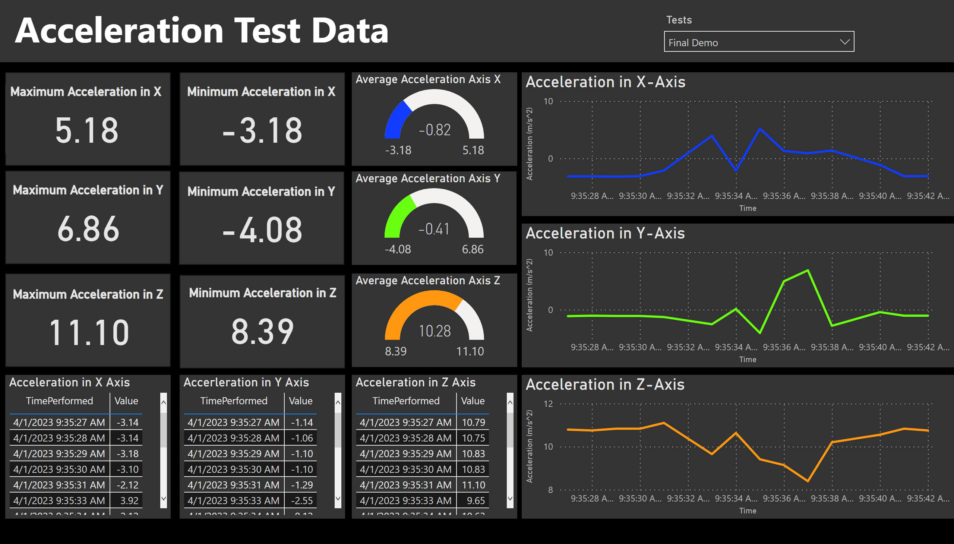







Key Features
How It Works
Maximize testing productivity with our streamlined solution
1
Connect sensors to the device
20 meters of wireless connectivity
2 hour of wireless testing time
2
Login to our User Interface
3
Configure sensors for your test
4
Start and stop data collection through the UI
5
Submit the data to the database
6
View tabulated and graphical depictions of your test
Auto-code generation for sensor configuration
Technologies
Stephen | Muhanad | Ahmed | Tioluwalayomi
Find and view any past test with KPI metrics and graphics
FORMULATE

